Slide 1
SQLite

Slide 2
SQLite
Serverless SQL Database Engine
Implements most features of SQL
Android API uses the built-in SQLite database.
Each database is private to the application
  Can share the database as content provider

Slide 3
Database
A flat-file database stores information in a single table
A relational database stores information across multiple related tables
Relational databases consist of one or more related tables
A primary table is the main table in a relationship that is referenced by another table
A related, or child, table references a primary table in a relational database

Slide 4
Database
The information stored in computer databases is stored in tables similar to spreadsheets
Each row in a database table is called a record
A record in a database contains a single complete set of related information
Each recipe in a recipe database, for instance, is a single database record

Slide 5
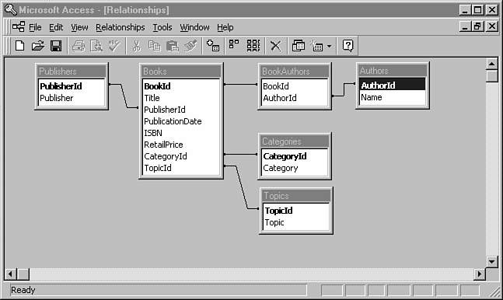
Database
The key entity within a relational database is a table.
For example, in the TechBooks database, there are several tables: Books, Authors, Publishers, Topics, Categories, and BookAuthors

Slide 6
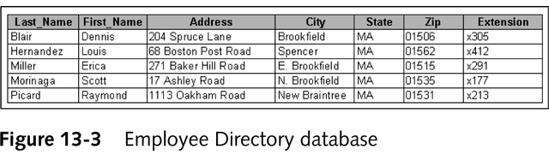
Database---Field
Each column in a database table is called a field
Fields are the individual pieces of information stored in a record
Figure 13-2 shows an example of an employee directory for programmers at an application development company

Slide 7

Database---Record
The data itself, as stored in each table, is called that table’s records.
Records are also called rows. In relational database terminology, records and rows are equivalent

Slide 8
Database---Cursor
When you have tables, columns, and records, the next logical step is to look at and modify the data in your table’s columns.
A cursor represents a current record in a table.
The cursor contains an internal reference to the row that your program is visiting.

Slide 9
Database---Keys
Tables in a relationship are connected using primary and foreign keys
A primary key is a field that contains a unique identifier for each record in a primary table
A foreign key is a field in a related table that refers to the primary key in a primary table
Primary and foreign keys are what link records across multiple tables in a relational database
A one-to-one relationship exists between two tables when a related table contains exactly one record in the primary table

Slide 10
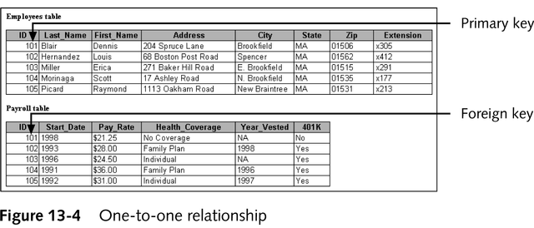
Database---Keys

Slide 11
Database Management Systems
Two other important aspects of database management systems are querying and reporting capabilities
A query is a structured set of instructions and criteria for retrieving, adding, modifying, and deleting database information
A report is the formatted, printed output of a database table or the results of a query
Most database management systems use a data manipulation language, or DML, for creating queries

Slide 12
Database Management Systems
Different database management systems support different data manipulation languages
However, structured query language, or SQL, has become somewhat of a standard data manipulation language among many database management systems

Slide 13
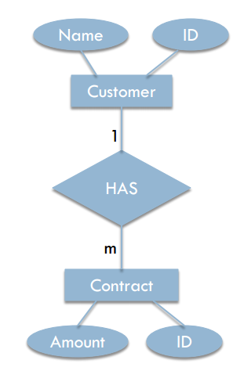
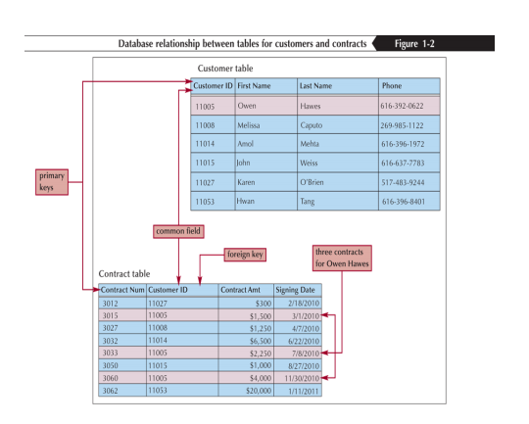
Relational Database
In the relational database management system(RDBMS), the data is represented as a set of relations

Slide 14
Structured Query Language(SQL)
IBM invented SQL in the 1970s as a way of querying databases for specific criteria
Since then, SQL has been adopted by numerous database management systems running on mainframes, minicomputers, and PCs
In 1986 the American National Standard Institute (ANSI) approved an official standard for the SQL language
In 1991 the X/Open and SQL Access Group created a standardized version of SQL known as the Common Applications Environment (CAE) SQL draft specification

Slide 15
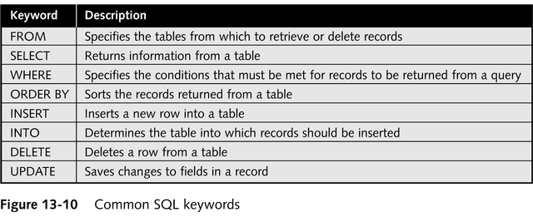
Structured Query Language(SQL)
Figure 13-10 lists several SQL keywords that are common to most versions of SQL

Slide 16
SELECT
The SQL SELECT statement enables you to retrieve data from one or more database tables flexibly.
There are four parts to the SELECT statement: the columns to display, the table that owns the columns, the record selection criteria, and the returned sort order. Its format is as follows:
SELECT list of columns FROM list of tables WHERE Boolean criteria for selection ORDER BY list of columns

Slide 17
SELECT
To obtain the titles and ISBN numbers for all the books
SELECT [Title], [ISBN] FROM [Books]
To obtain the titles and ISBN numbers for only books with a retail price greater than $25
SELECT [Title], [ISBN] FROM [Books] WHERE [RetailPrice] > 25.0

Slide 18
INSERT
The SQL INSERT statement enables you to add another row of data to a table.
The INSERT statement has two formats.
  The first format enables you to specify the values to place in each column for the inserted row.
  INSERT INTO table (list of columns)
  VALUES (list of comma-delimited values)
  The alternative format enables you to synthesize a row of data for the table using a SELECT statement. This format is as follows:
  INSERT INTO table SELECT list of columns FROM list of tables WHERE Boolean criteria for selection ORDER BY list of columns

Slide 19
INSERT
For example, if you’d like to add a new topic to the TechBooks Topics table, you can use the following SQL command:
INSERT INTO [Topics] (TopicId, Topic) VALUES(11, ‘ANDROID’)

Slide 20
DELETE
The SQL DELETE statement removes rows from a table based on the criteria specified in its optional WHERE clause. The format of the DELETE statement is as follows:
DELETE FROM table WHERE Boolean criteria for deletion
Example: For example, in the TechBooks database, to delete all books whose price is greater than $20
DELETE FROM [Books] WHERE [RetailPrice] > 20.00

Slide 21
UPDATE
The SQL UPDATE statement changes column data that is present in a table. The format of the UPDATE statement is as follows:
UPDATE table SET column = value WHERE Boolean criteria for updating
For example in the TechBooks database, if you need to change the name of the “Publisher” topic to “Publishing Software” in the Topics table
UPDATE [Topics] SET [Topic] = ‘Publishing Software’ WHERE [Topic] = ‘Publisher’

Slide 22
SQL DDL
The Data Definition Language (DDL) part of SQL permits database tables to be created, altered or deleted.
The most important DDL statements in SQL are:
  CREATE TABLE - creates a new database table
  ALTER TABLE - alters (changes) a database table
  DROP TABLE - deletes a database table
  CREATE INDEX - creates an index (search key)
  DROP INDEX - deletes an index

Slide 23
SQL DDL
Create Table
CREATE TABLE t1 ( t1key INTEGER PRIMARY KEY, data TEXT, num double NOT NULL, timeEnter DATE );
SQLite supports the data types:
  TEXT (similar to String in Java),
  INTEGER (similar to long in Java) and
  REAL (similar to double in Java).
All other types must be converted into on of these fields before saving them in the database.
SQLite itself does not validate if the types written to the columns are actually of the defined type, you can write an integer into a string column.

Slide 24
SQLite
No special permission is required to use SQLite.
All databases, SQLite and others, are stored on the device in /data/data/package_name/databases.
To work with an SQLite database, you must communicate with SQLite through classes in the android.database package.
You can either code “low-level” SQL or use the database API
Create a class that extends SQLiteOpenHelper, and put all database functionality in that class

Slide 25
SQLite OpenHelper
A helper class is used to manage database creation.
To create and upgrade a database in your Android application you usually subclass "SQLiteOpenHelper".
In this class you need to override the methods:
  onCreate() to create the database and
  onUpgrade() to upgrade the database in case of changes in the database schema.
  Both methods receive an "SQLiteDatabase" object.
SQLiteOpenHelper provides the methods getReadableDatabase() and getWriteableDatabase() to get access to an "SQLiteDatabase" object which allows database access either in read or write mode.
For the primary key of the database you should always use the identifier "_id" as some of Android functions rely on this standard.

Slide 26
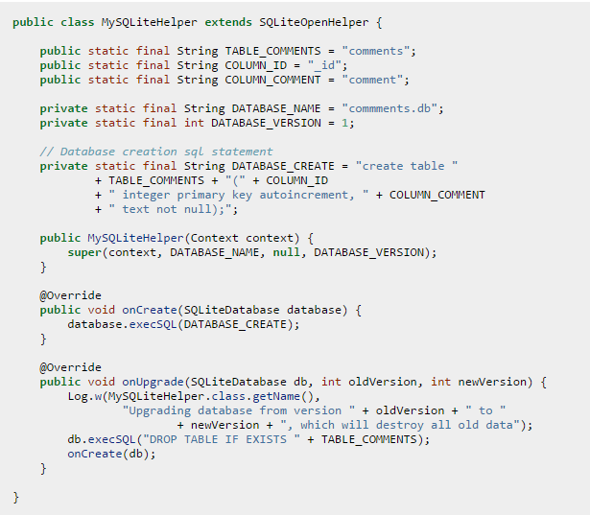
SQLiteOpenHelper

Slide 27
Android API
To utilize database functionality on the Android platform, we first subclass the SQLiteOpenHelper class which provides the interface to the database. This class requires that three methods be present:
Constructor - which calls the base class constructor.
onCreate() - which can be used to build an initial database, e.g. from string constants stored in string.xml
onUpgrade() - which can be used to modify a database based on a version number allowing migration from one schema to another (or possibly just deleting all previous tables and creating new ones)

Slide 28
Android API
Alternatively, rather than having the application create the database at run time, an SQLite database file can be included in the assets directory of the project (which subsequently will be embedded in the .apk file) and then simply copied onto the local database file.
Android provides two options for accessing data in a SQLite database
use the query(), insert(), update(), and delete() methods in the SQLiteDatabase class to perform transactions on the database
use the execSQL() method to execute a single SQL statement against the database

Slide 29
Query()
One common form of the query() method is
Cursor query(String table, String[] columns, String selection, String[] selectionArgs, String groupBy, String having, String orderBy)
The query will return a Cursor_ object (which is similar to a ResultSet in mySQL) and requires several parameters:
  table - the name of the table to run the query against
  columns - the list of columns to return the values of in the Cursor
  selection - filter for which rows to return, i.e. the WHERE clause without the WHERE keyword (set to null to return all rows)
  selectionArgs - a list of values to substitute for ? placeholders in the selection
  groupBy - filter corresponding to the GROUP BY SQL clause (null for no grouping)
  having - filter corresponding to the HAVING clause (null for no filter)
  orderBy - filter corresponding to the ORDER BY clause (null for default sort order)
For example, a query() for an item with name "Apples" might be
Cursor c = db.query(INVENTORY_TABLE, null, "name=?", "Apples",null,null,null);

Slide 30
Insert()
The form of the insert() method is
long insert(String table, String nullColumnHack, ContentValues values)
The method returns the id of the inserted row (or -1 if an error occurs) has parameters:
  table - the name of the table to run the query against
  nullColumnHack - prevents an empty row from being inserted by specifying a column name to insert a null into (usually set to null)
  values - a ContentValues map that specifies the column name/value pairs to be inserted into the row.
For example, an insert() for an item with name "Oranges" and quantity 10 might be:
ContentValues vals = new ContentValues(); vals.put("name","Oranges");
vals.put("quantity",10);
long row = db.insert(INVENTORY_TABLE, null, vals);

Slide 31
Update()
The form of the update() method is
int update(String table, ContentValues values, String whereClause, String[] whereArgs)
The method returns an integer indicating the number of rows that were modified and has parameters:
  table - the name of the table to run the query against
  values - a ContentValues map that specifies column names/new values to be updated
  whereClause - filter to specify matching criteria to only update particular matching rows (null updates all rows)
  whereArgs - a list of values to substitute for any placeholders in the whereClause
For example, to change the quantity of "Oranges" to 42 might be:
ContentValues vals = new ContentValues();
vals.put("quantity",42);
int numRows = db.update(INVENTORY_TABLE, vals, "name=?", "Oranges");

Slide 32
Delete()
The form of the delete() method is
int delete(String table, String whereClause, String[] whereArgs)
The method returns an integer indicating the number of rows that were removed (if a whereClause is specified, 0 otherwise) and has parameters:
  table - the name of the table to run the query against
  whereClause - filter to specify matching criteria to only delete particular matching rows (null deletes all rows)
  whereArgs - a list of values to substitute for any placeholders in the whereClause
For example, a delete() to remove "Oranges" might be:
int delRows = db.delete(INVENTORY_TABLE, "name=?", "Oranges");

Slide 33
ExecSQL()
The form of the execSQL() method is
void execSQL(String sql, Object[] bindArgs)
The method cannot return a value and thus cannot be used with SELECT statements. It has a single parameter:
  sql - which is a string representing the SQL statement to execute
  bindArgs - a list of values to substitute for any placeholders
For example, an alternative to the previous delete() call might be:
String delSql = "DELETE FROM " + INVENTORY_TABLE + "WHERE name = ?";
Object[] bindArgs = new Object[]{"Oranges"};
db.execSQL(delSql, bindArgs);

Slide 34
Cursor
For SQLite queries that return data, e.g. SELECT statements, the results are provided in an object known as a Cursor (sometimes subclassed to provide ORM functionality). Cursor objects have several commonly used methods:
  getCount() - returns the number of rows returned by the query
  moveToFirst() - reset the cursor to the first returned row
  moveToPosition(int i) - sets the cursor's position to the i^{th} row
  close() - clean up the cursor resources
  getColumnIndexOrThrow(String name) - retrieves the column index for a given column name
  getInt(int idx), getString(int idx), etc. - gets the value of the field for column index idx as the corresponding datatype

Slide 35
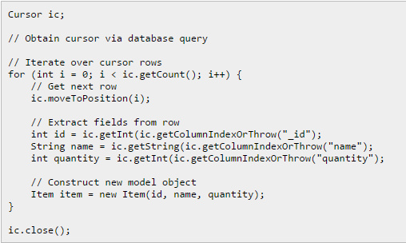
Cursor
Hence, if we assume that we have a Cursor returned from a query we could construct objects using:

Slide 36
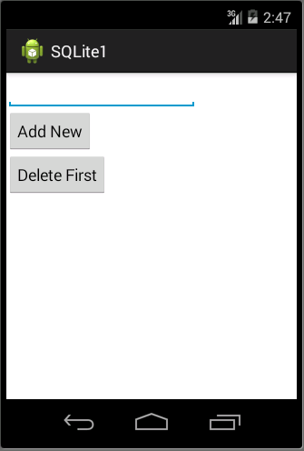
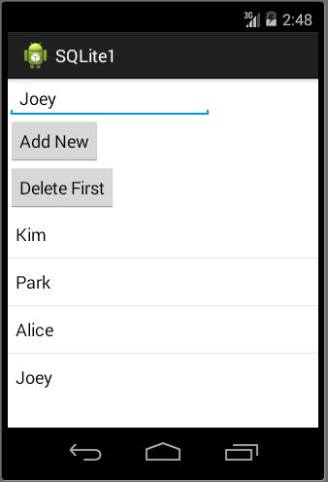
Example---Student Record

Slide 37
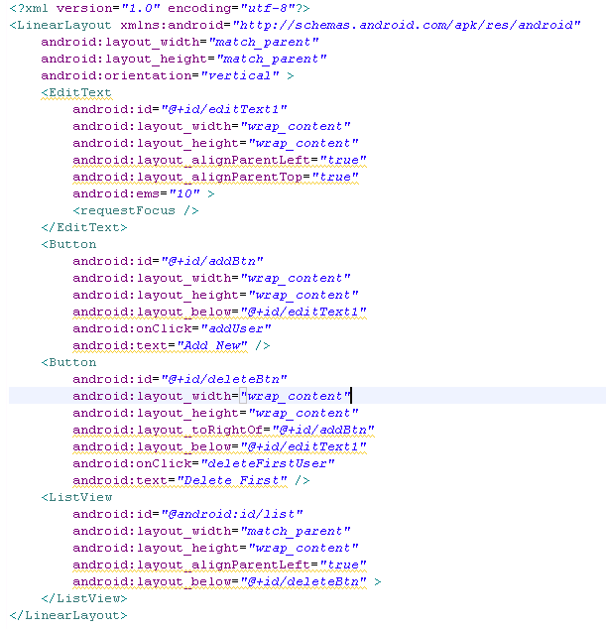
Activity_main.xml

Slide 38
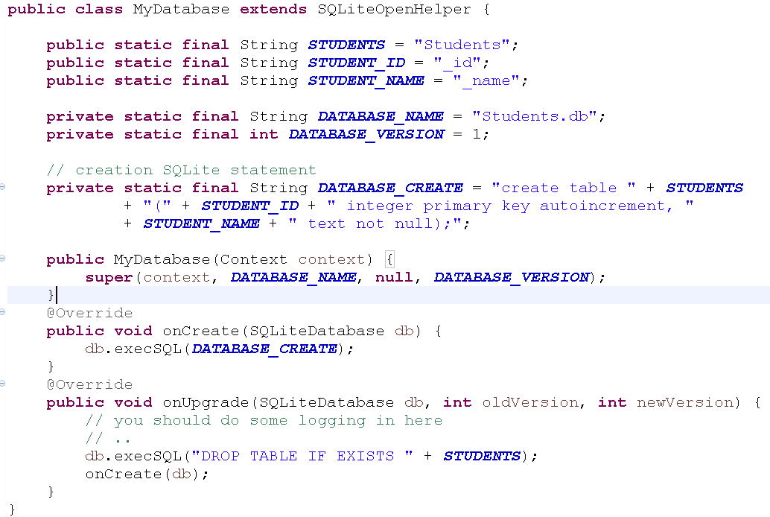
MyDatabase.java

Slide 39
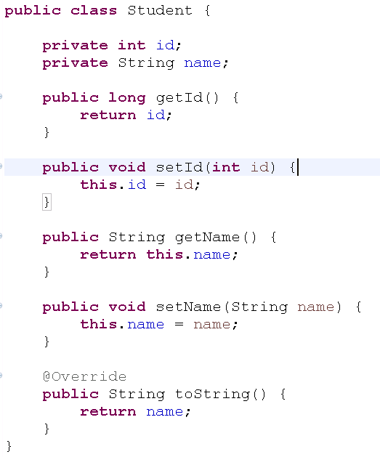
Student.java

Slide 40
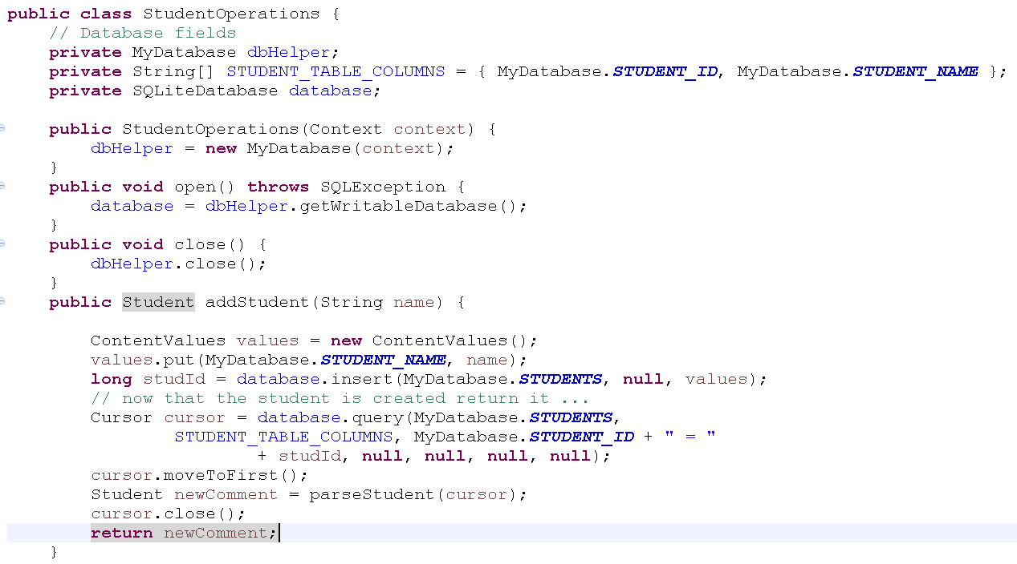
StudentOperations.java(1)

Slide 41
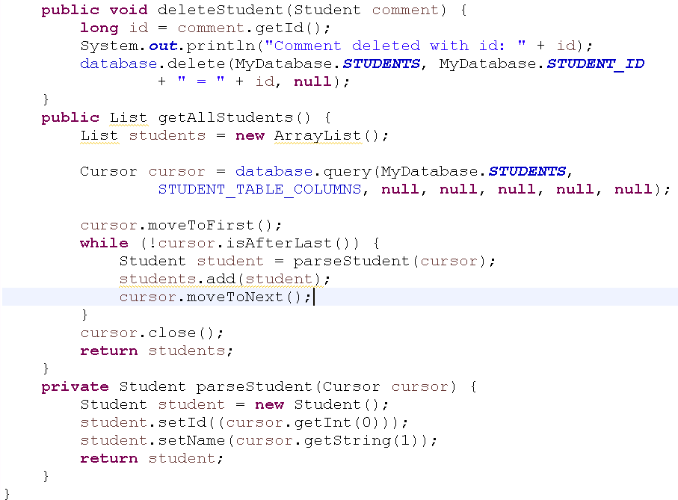
StudentOperations.java(2)

Slide 42
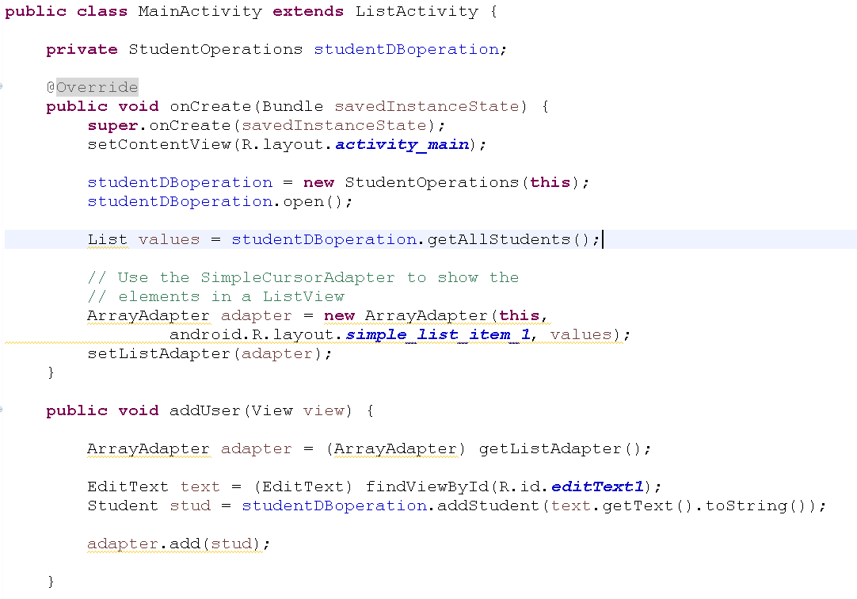
MainActivity.java(1)

Slide 43
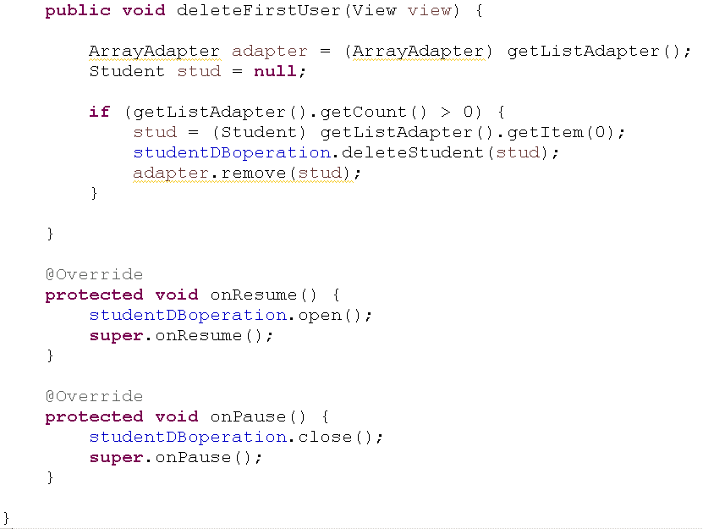
MainActivity.java(2)

